Slide 1
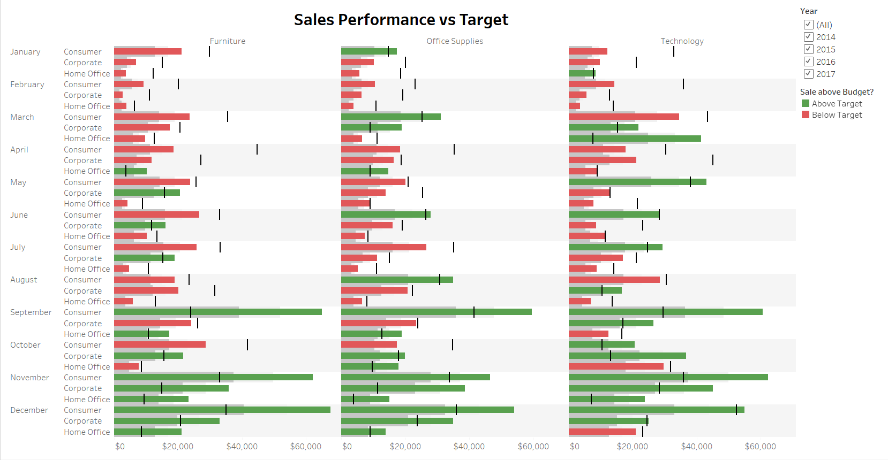

Slide 2
Project Description ( Min 5 points)
In September for all the years, consumer furniture was the top category that exceeded their target sales.
Generally, most segments in the furniture category did not meet their target sales.#
Technology and Office Supplies did okay in reaching their target sales
In 2015, Home Office under the furniture category met their target in december and home office under technology in November met their target.
When looking at all the years, some categories meet their target sales but when focusing on a year by year basis, most categories fall short of the target sales.

